Slide 1
The Shell Centre for Mathematical Education
- the story so far
Hugh Burkhardt
Shell Centre Jubilee Conference
September 2017
Notes:
Systemic change and teaching modelling
Over the last sixty years, teaching modelling has moved from initial explorations to becoming an established field, supported by research and the development well-engineered tools of various kinds. Yet, in typical classrooms around the world, autonomous student modelling remains rare. Recently, in Britain and the US at least, modelling has become an explicit element in the “intended curriculum”. But the usual difficulties of embedding innovation across an education system remain. This talk will analyse these barriers and, drawing on past initiatives around the world, suggest what may be needed to overcome them.

Slide 2


George Hall Founders Heini Halberstam
Notes:
I’m still alive, but that’s all. [said in good humour]. Best wishes for this conference. I am sorry I am not able to be with you today. Heini Halberstam and I were close friends and colleagues because of our love of mathematics and its wider use.’

Slide 3
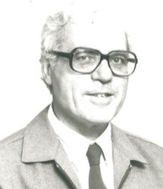

1967-76 Professional Development
Three staff:
Alan Bell
Robert Lindsay
Ruth Tobias, then
David Hale
1972 Chair in
Mathematics Dept
& Shell Centre
Vernon Armitage
+ Alan Bell wrote
Journey into Maths
with two local Heads of Maths
David Rooke & Alan Wigley
for Years 7 and 8

Slide 4
1976 a new Shell Centre ‘Brief’
To work to improve the
teaching and learning of mathematics
regionally, nationally and internationally
Impact in mathematics classrooms
became the key focus of
Shell Centre R&D

Slide 5
Strategy
Recognize curriculum failure: so many people lack confidence in, and enjoyment of, mathematics
Strategic levers: crucial to find levers that will encourage teachers to make the effort change involves – then to support them in doing so.
Large-scale influence can only be achieved by 5 people through reproducible materials that support more effective teaching
This implied a central role in our work for
imaginative design-linked research, then development
THIS NEEDS A TEAM

Slide 6
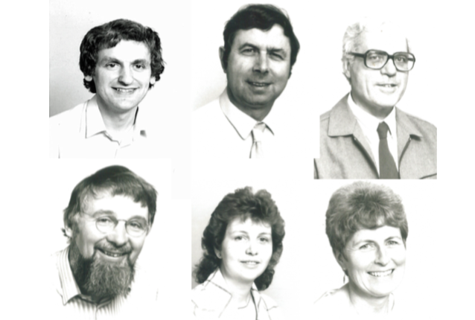
The 1980s team

Slide 7
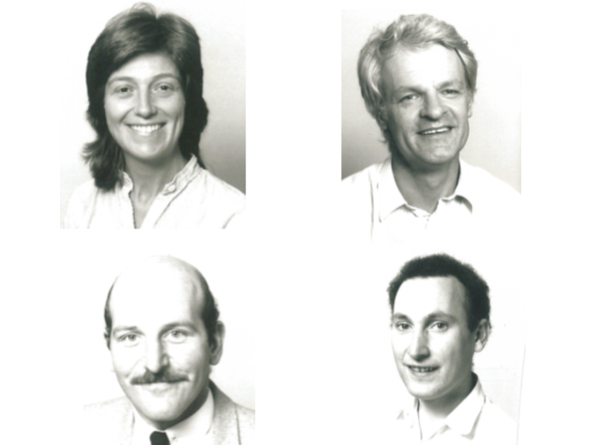
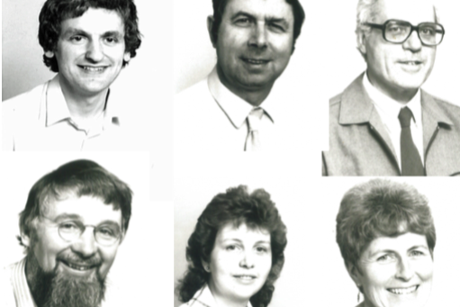
The 1980s researcher-designers

Slide 8
Strands of R&D
Though much of the time we have been funded from project to project, we have managed to maintain some coherent strands:
Ways the computer can help
Using assessment to drive improvement
Diagnostic teaching = formative assessment
Modelling the real world
Time for a few slides on each; more in the Exhibition

Slide 9
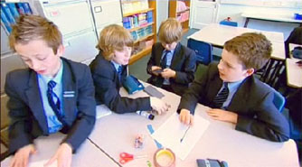
Computer assisted learning and assessment
1978 -

Slide 10
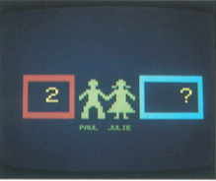
Computers and design - ITMA
Rosemary Fraser
Richard Phillips

Slide 11
Research insights e.g. Role Shifting
Directive roles
Manager T>S
Explainer T>S
Task setter T>S
New supportive roles
Counsellor T+S
Fellow student T
Resource T
Role shifting raises levels of learning
It changes the “classroom culture”
Role Shifting became a design principle

Slide 12
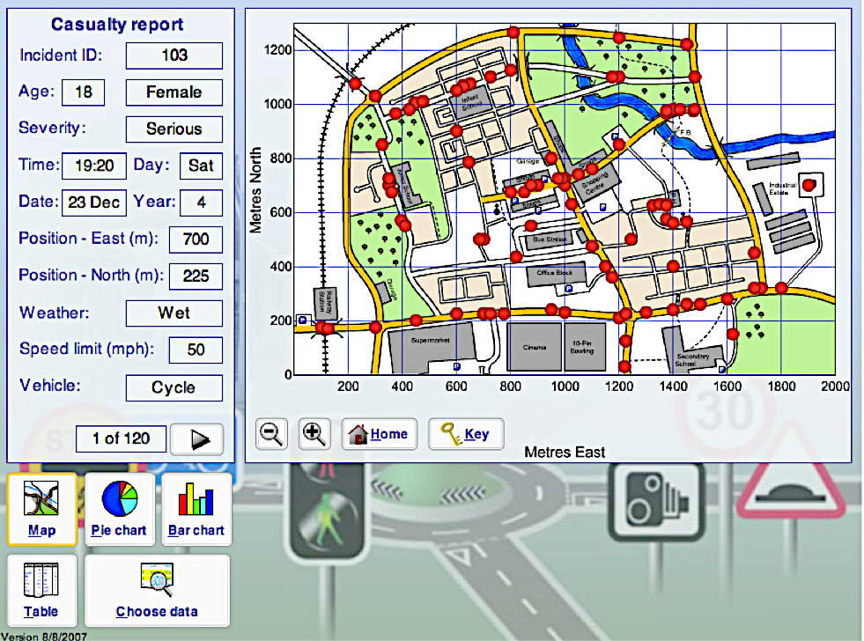

Slide 13
Using exams to drive improvement
1980 -

Slide 14
WYTIWG: Testing Strategic Skills
Improvement by gradually improving board exams
One new task type each year – with two years notice
Providing effective support modules for teachers
  5 exemplar examination tasks – show variety to expect
  Teaching materials for 3 weeks innovative teaching
  Materials for in-school activity-based CPD, including software and video of teaching.
The print materials can be downloaded from http://www.mathshell.com/materials.php?item=&series=tss

Slide 15
Examples of Task Types
Plan and organise
  Find optimum solution subject to constraints.
Design and make
  Design an artefact or procedure and test it
Model and explain
  Invent, interpret, explain models.
Explore and discover
  Find relationships, make predictions
Interpret and translate
  Deduce information, move between representations of data
Evaluate and improve
  Review and improve an argument, a plan, an artefact

Slide 16

Problems with Pattern and Numbers
“The Blue Box”
Tasks: non-routine problems in pure mathematics
Teaching: focused on problem solving strategies
Practice on diverse problems
PD: focus on support without taking over

Slide 17
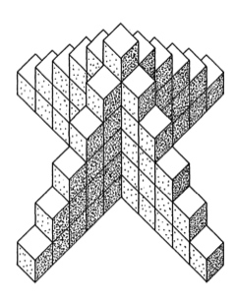
Skeleton Tower
How many cubes do you need to make a tower
  6 cubes high?
  20 cubes high?
  n cubes high?
  Explain your reasoning.
  Can you find another method?

Slide 18
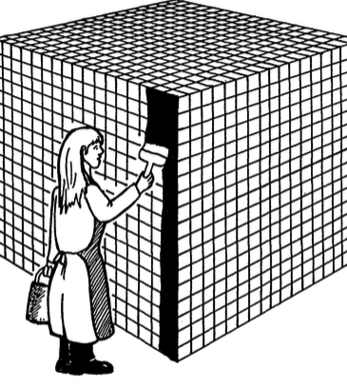
The Painted Cube
When she has painted all the outside surfaces black, how many of the
4,913 = 17x17x17
little cubes will have
0, 1, 2, 3, 4, 5, 6
black faces?
Then:
How many for an nxnxn big cube?

Slide 19
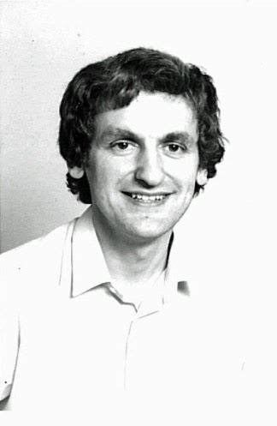
Design and development
Shell Centre projects are team efforts
For PPN, the Manchester ATM Group created tasks and ideas, Shell Centre team developed them;
design control lay with:
  Strategic design: Hugh Burkhardt
  Tasks: John Pitts, JMB Examiner
  Teaching materials: Malcolm Swan
  PD materials: Rosemary Fraser
The editor was Malcolm Swan,
who had worked for 4 years on …...

Slide 20

The Language of Functions and Graphs
“The Red Box”
Tasks: Interpreting nd sketching line graphs
Teaching: focused on getting meaning from representations
Practice on diverse problems
PD: focus on non-directive classroom discussion

Slide 21
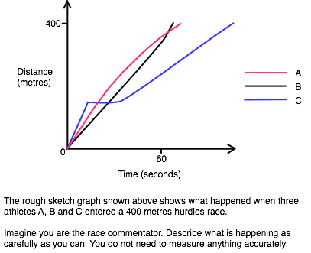
Testing Strategic Skills: Hurdles Race

Slide 22
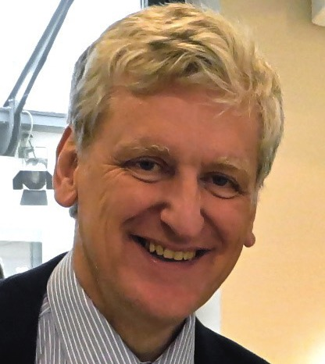
ISDDE Prize for Excellence in Design
Malcolm Swan
lead designer for TSS
was awarded the first
“Eddie”
for “LFG” in 2008
- 23 years after it was published

Slide 23
TSS Impact
New task types were assessed in this high-stakes examination; some were later absorbed into mainstream assessment, more or less faithfully.
New strategic design features:
  Use ‘what you test is what you get’ (WYTIWYG)
  Well-supported gradual change
  Move towards alignment of exam with its goals
  Materials-supported professional development.
Most of the board’s schools bought the modules
Teachers and students enjoyed it.

Slide 24
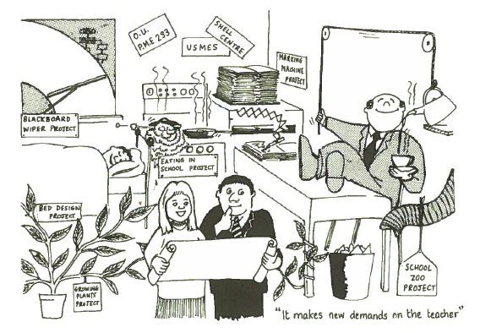
Support for the teacher

Slide 25
Reorganisation …..!
As an unintended consequence of the move to GCSE, the Joint Matriculation Board’s role in 16+ examining was taken over by the new GCSE awarding bodies > NEAB > AQA
As always with reorganisations, everybody’s energy was absorbed in “the move”
So the relationship with the Shell Centre was broken and TSS ended.

Slide 26
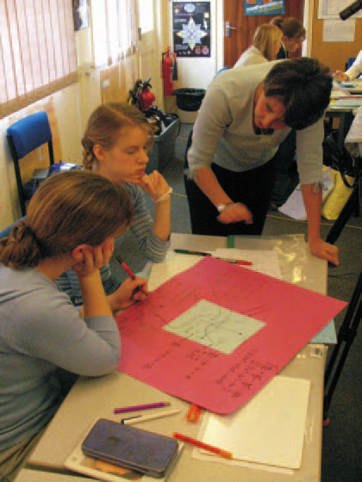
Methodology

Slide 27
Authoring v Engineering
Teaching materials must have, for any learning goal:
Classroom activities in which children engage and learn
Communicated in a way that works for typical teachers
Authorship Model
Draft from author’s experience, get comments, revise, publish
Often achieves A; less often B
Engineering model
Draft, get comments, revise then – to achieve B, iterate:
Trials, structured observation, analysis, feedback, revision
until it works in typical classrooms
Seems expensive (£10,000 a lesson) – trivial in system terms

Slide 28
Aspects of design
Strategic design
  focuses on the design implications of the interactions of products with the system they aim to serve.
  Important because of the many wonderful lessons, assessment tasks, and professional development activities that are never seen, while mediocrity is widespread
Structural design
  focuses on product structures that promise power in forwarding the strategy
Technical design
  Principles built around research on learning and teaching

Slide 29
Technical design principles
Students learn through
  active processing – discussion, reflection, social classroom
  internalisation and reorganisation of experience.
Activate pre-existing concepts.
Allow students to build multiple connections.
Stimulate tension / conflict to promote re-interpretation, reformulation and accommodation.
Devolve problems to students.
Students need to articulate Interpretations.
‘Production of answers’ must give way to reflective periods of ‘stillness’ for examining alternative meanings and methods.
Reasoning – not just answers
Principles are not enough – design needs creative detail

Slide 30
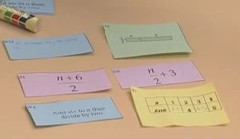
Diagnostic Teaching = Formative Assessment
1984 -

Slide 31
Structure of a formative assessment lesson
Expose and explore students’ existing ideas
  “pull back the rug”
Confront with implications, contradictions
  provoke ‘tension’ and ‘cognitive conflict’
Resolve conflict through discussion
  allow time for formulation of new concepts
Generalise, extend and link learning
  apply to new contexts.

Slide 32
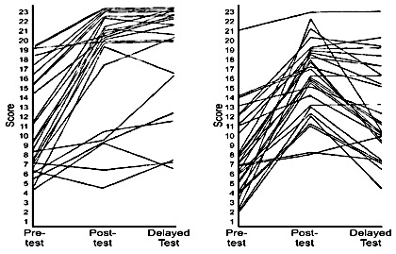
Student scores for one class
Diagnostic teaching v Direct instruction
Exploring boundaries of validity
This is one result among many similar on other topics
Only common patterns lead to design principles, so we need big programs

Slide 33
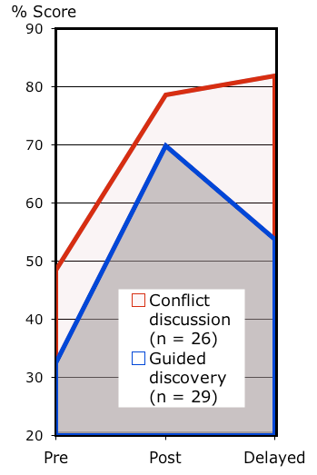
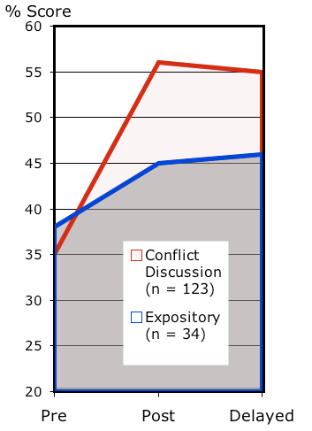
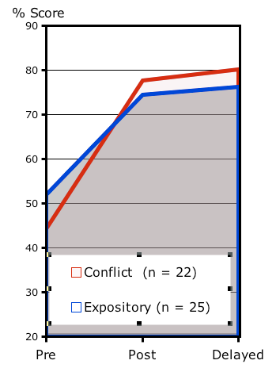
Replication: exploring generalizability
Reflections Rates Decimals

Slide 34
Task “genres” for concept development
Translation: linking multiple representations
  What is another way of showing this?
Testing assertions & “misconceptions”
  Always, sometimes or never true?
Classifying objects & challenging definitions
  What is the same and what is different?
Modifying problems & exploring structure
  What happens if I change this?
  How will it affect this?
Notes:
Knowledge, learning, understanding are not linear. They are not little bits of facts lined up in rows or piled up one on top of the other. A field of knowledge (such as mathematics) is a territory, and knowing it is not just a matter of knowing all the items in the territory, but of knowing how they relate to, compare with, and fit in with each other. It is the difference between being able to say that a room in your house has so many tables, so many chairs, so many lamps, and being able to close your eyes and see that this chair goes here and that table there. It is the difference between knowing the names of all the streets in a city and being able to get from any place, by any desired route, to any other place.
“How Children Fail” John Holt Pelican Books 1984
34

Slide 35
Always, sometimes or never true?
When you cut a piece off a shape you reduce its area and perimeter
Notes:
35
35

Slide 37
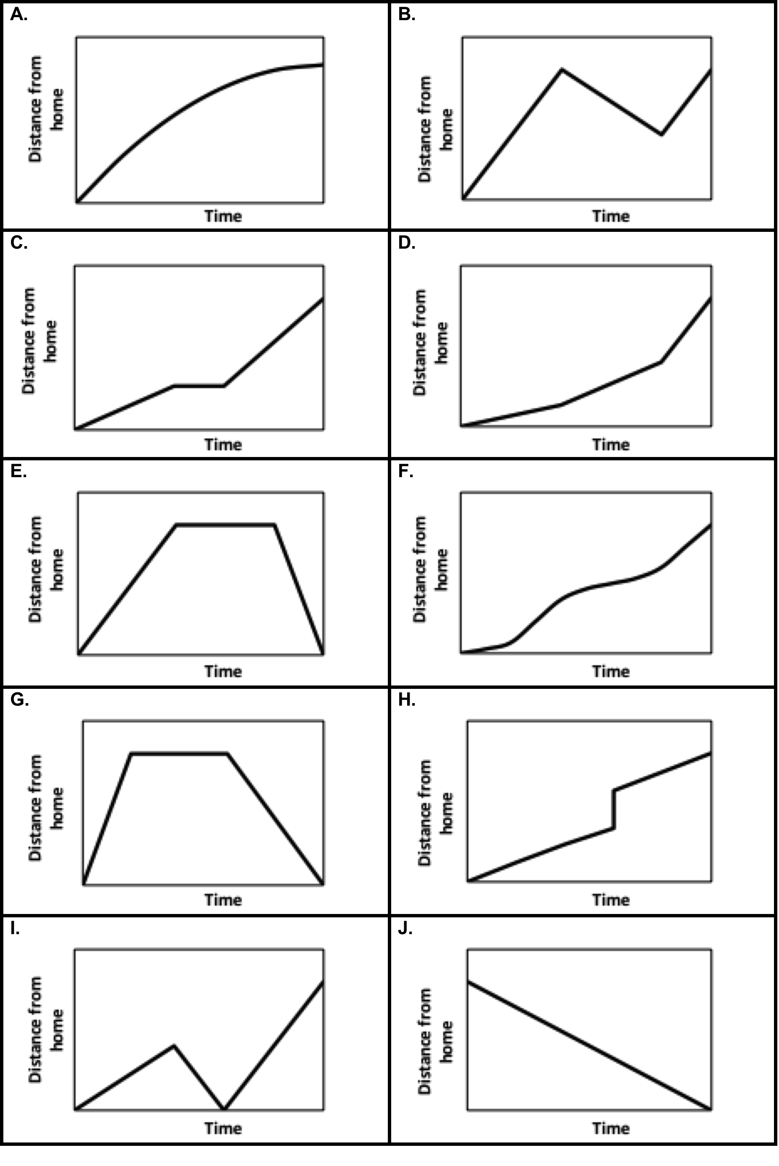
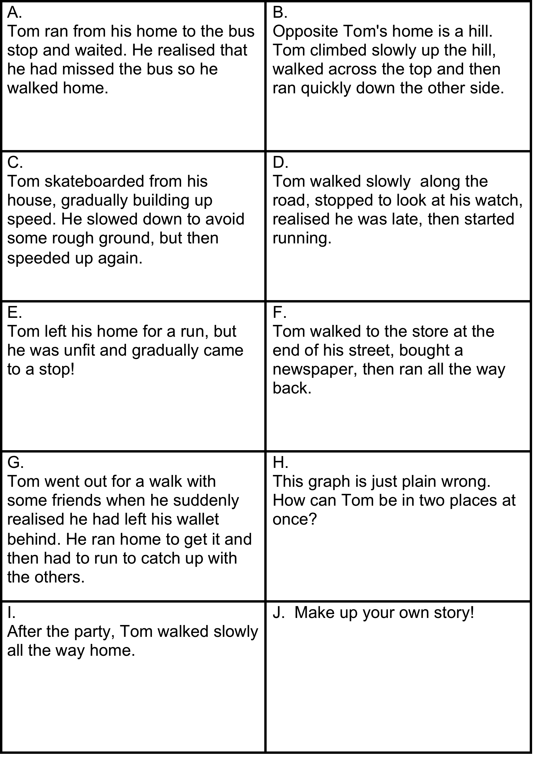

Slide 38

Mathematical modelling in classrooms
1964 -

Slide 39
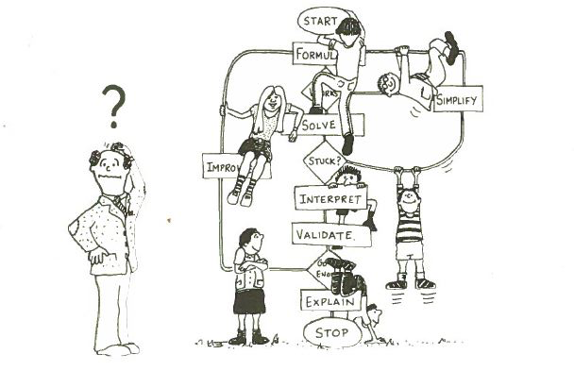
Modelling with Mathematics

Slide 40
Mathematical literacy (PISA, 2015)
“The modelling cycle is a central aspect of the PISA conception of students as active problem solvers”
Problem in context
Mathematical problem
Formulate
Employ
Evaluate
Results in context
Interpret
Mathematical results
Notes:
The focus … is on active engagement in mathematics, and is intended to encompass reasoning mathematically and using mathematical concepts, procedures, facts and tools in describing, explaining and predicting phenomena.
In particular, the verbs ‘formulate,’ ‘employ,’ and ‘interpret’ point to the three processes in which students as active problem solvers will engage. Formulating situations mathematically involves identifying opportunities to apply and use mathematics – seeing that mathematics can be applied to understand or resolve a particular problem or challenge presented. it includes being able to take a situation as presented and transform it into a form amenable to mathematical treatment, providing mathematical structure and representations, identifying variables and making simplifying assumptions to help solve the problem or meet the challenge. Employing mathematics involves applying mathematical reasoning and using mathematical concepts, procedures, facts and tools to derive a mathematical solution. It includes performing calculations, manipulating algebraic expressions and equations or other mathematical models, analysing information in a mathematical manner from mathematical diagrams and graphs, developing mathematical descriptions and explanations and using mathematical tools to solve problems. Interpreting mathematics involves reflecting upon mathematical solutions or results and interpreting them in the context of a problem or challenge. It includes evaluating mathematical solutions or reasoning in relation to the context of the problem and determining whether the results are reasonable and make sense in the situation.

Slide 41



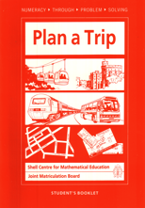
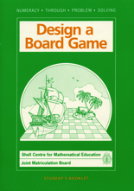

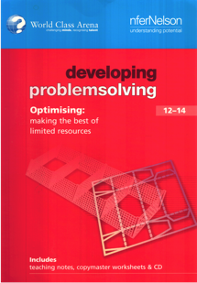

The Modelling Projects
1981 | The Real World and Mathematics
1981 - 1986 | Testing Strategic Skills Task exemplars, Boxes, WYTIWYG, Alignment, Gradual change
1987 - 1989 | Numeracy through Problem Solving Modelling in maths, materials-directed project work, group investigations, exams on projects, controlled transfer distance
1985 - 1988 | Extended tasks for GCSE Maths Materials supporting ‘coursework’/portfolios
1999 - 2005 | World Class Arena Test of PS across STEM, Expert tasks ~ high strategic/low technical demand, computer-based tasks, microworlds
2007 - 2014 | Bowland Maths Investigative video/software driven microworlds, PD package
2011 - 2013 | Promoting Inquiry in Mathematics and Science Professional Development for Inquiry-based Learning
2009 - 2014 | Mathematics Assessment Project Supporting formative assessment through materials
2014 - 2015 | Lessons for Mathematical Problem Solving (LeMaPS) Using Lesson Study for Professional Development in Modelling

Slide 42
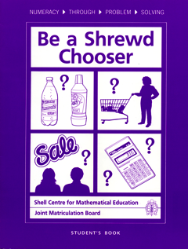




Each module has 4 stages
Stage 1: Looking at existing examples
  Students analyze existing products or processes and critique them
  Students identify criteria/ structures for successful products
Stage 2: Planning an approach
  Students brainstorm ideas, select one to work on, study the techniques they need and plan their work.
Stage 3: Carrying out the approach
  Students carry out their plan, make a prototype.
Stage 4: Presenting and evaluating the outcomes
  Students make/enact the product/process.
  Students test and evaluate each others’ work.
Notes:
Students design and make a product from paper or card and then produce a kit containing full instructions so that someone else can make it.

Slide 43
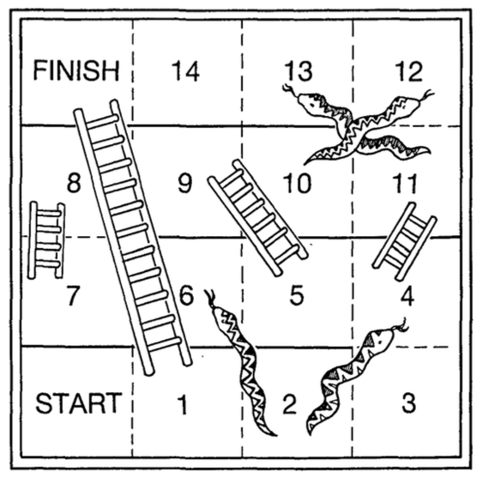
Evaluate and Improve
Snakes and Ladders Game:
Toss a coin
Heads: move 2 spaces
Tails: move 1 space
Find and describe design faults
Now design a better version

Slide 44

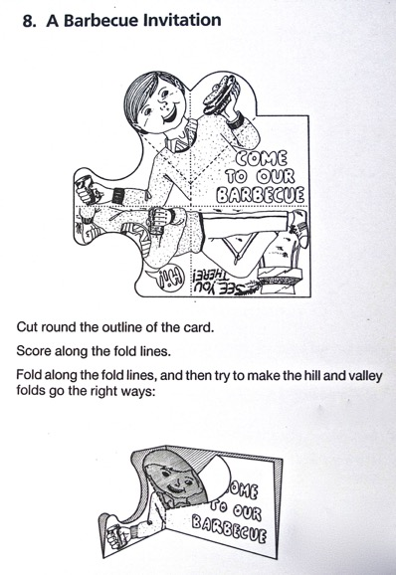
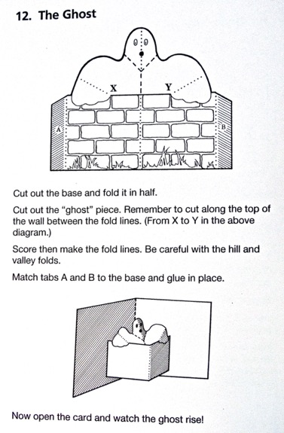
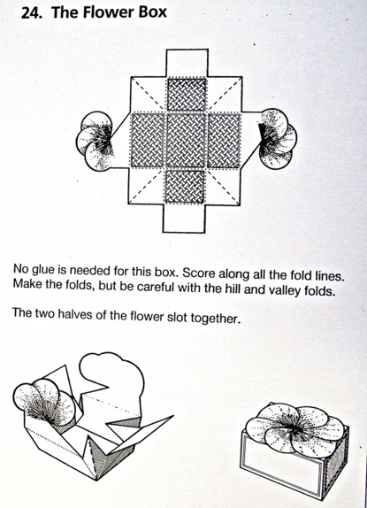
Stage 1: Looking at examples
Students, share the work of making 30 boxes, envelopes, pop-up cards.
They classify them according to their structure.
They bring in outside examples from home as well.

Slide 45


Design and Make a Party Invitation
Show where you would put the cut and fold lines to make the pop-up card shown here.

Slide 46
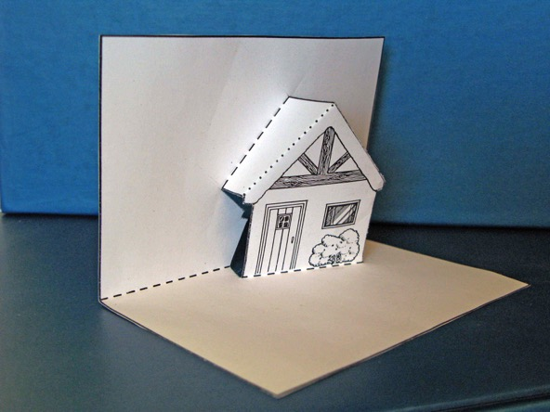
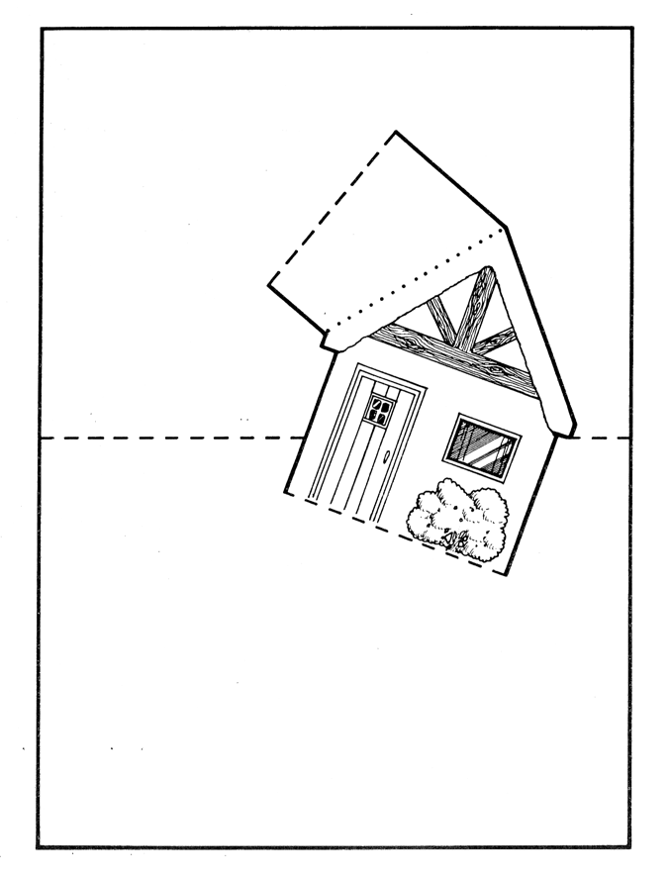
Stage 2: Exploring techniques
If this card is to work properly, what can you say about:
the directions of the fold lines;
the angles between the fold lines?

Slide 47
A MAP Problem Solving Lesson
Initial, individual, unscaffolded problem
  Students tackle the problem unaided.
  Teacher assesses work and prepares qualitative feedback.
Individual work
  Students write responses to teacher’s feedback
Collaborative work
  Students work together to produce and share joint solutions
Students compare different approaches using sample work
  Students discuss student work in small groups, then as a whole class
Whole class discussion: the payoff of mathematics
  Students improve their solutions to the initial problem,
  or one very much like it.
Individual reflection
  Students write about what they have learned.

Slide 48
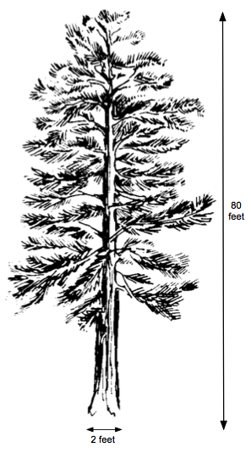
Making Matchsticks
Estimate how many matchsticks can be made from this tree
80 ft tall
2 ft diameter
at the base.
Matchsticks are
1/10 inch square
2 inches long

Slide 49
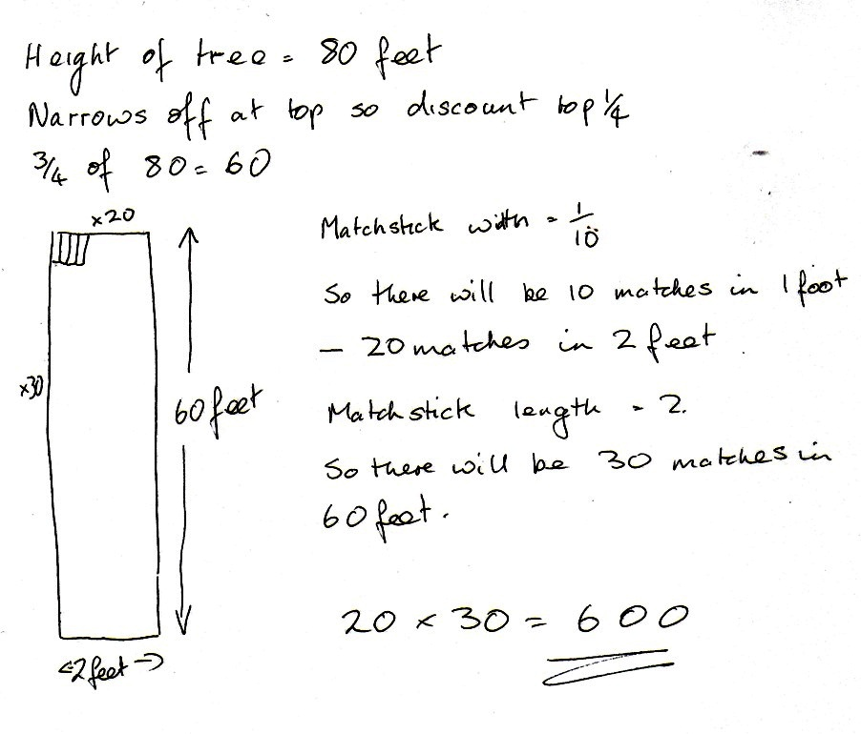
Sample response to discuss: Jaabir

Slide 50
Cats and Kittens

Slide 51
Issue | Suggested questions and prompts
Has difficulty starting | Can you describe what happens during first five months?
Does not develop suitable representation | Can you make a diagram or table to show what is happening?
Work is unsystematic | Could you start by just looking at the litters from the first cat? What would you do after that?
Develops a partial model | Do you think the first litter of kittens will have time to grow and have litters of their own? What about their kittens?
Does not make clear or reasonable assumptions | What assumptions have you made? Are all your kittens are born at the beginning of the year?
Makes a successful attempt | How could you check this using a different method?

Slide 52
Sample student work

Slide 53
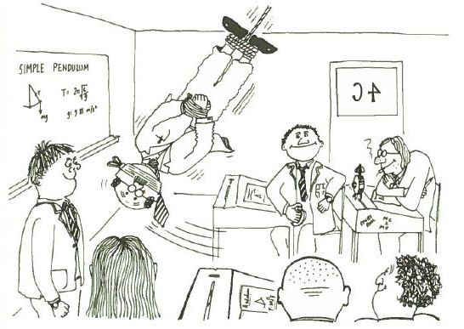
Modelling in the Classroom

Slide 54
Supporting teachers’ and system development
1967 -

Slide 55
Why tools for professional development?
• Shortage of PD leaders with the skills needed
• Designing PD that:
    actually changes classroom practice
    is cost-effective in teacher time
is a challenging design problem.
Key elements
  Activity based – active learning by teachers
  On-going – lifetime development
  In a framework – TRU
  supported by well-engineered tools

Slide 56
“The Sandwich Model” Bowland Math, MAP
Modules to address major pedagogical challenges:
The model is a three part “sandwich”:
  Introductory session:
  Teachers work on problems, discuss pedagogical challenges they present, watch video of other teachers using these problems and plan lessons.
  Into the classroom:
  Teacher teach the planned lessons.
  Follow-up session:
  Teachers describe and reflect on what happened, discuss video extracts, and plan strategies for future lessons.

Slide 57
System Change
We should recognize that we face Big Problems
Big Problems need big coherent research efforts
Big collaborative R&D programs to yield
Robust solutions
In other fields – these are organized:
LHC, Human Genome, …..
“Big Education” can learn from “Big Science”

Slide 58
Transforming practice through engineering research
Analysing existing situations
Designing new processes, products and experiences for teachers and learners
Articulating values and principles that underpin these “designs”
Analysing “designs in action” through trials
Revising and refining designs and theories in the light of these
“Scaling up” designs for use by others.

Slide 59

Where to find resources
http://map.mathshell.org
http://mathshell.org

Slide 60










Our Current Team
Colin Foster
Sheila Evans
Clare Dawson
Diane Dalby

Slide 61
The Shell Centre for Mathematical Education
– the story so far
Aspects of design
Some of my favourite creations
Rita Crust
Shell Centre Jubilee Conference
September 2017
Notes:
I don’t expect to need this slide.

Slide 62
Circle Pattern
Work out what fraction of the area is black in this sequence.
Notes:
Here is a problem that can be solved by bright 14-16 year old students .
But it’s not a good assessment task.
The next two slides provide an example of how I (and my team of writers) develop problems to design good formative assessment tasks.

Slide 63
Circle Pattern
Here is a developing circle pattern.
Here is one black circle.
Two white circles of half the radius
have been added to the diagram.
1. Show that the fraction of the
diagram that is now black is one half.
Notes:
Read quickly

Slide 64
Circle Pattern
Four black circles have now been added.
2. What fraction of the diagram is now black?
3. Make a table to show what happens as the pattern continues.
4. Write a description of what is happening to the black and white fractions as the pattern continues.

Slide 65
A well-designed assessment task
Provides access so nearly all students can demonstrate some level of success.
Gradually increases in complexity and cognitive challenge as the core mathematics is assessed.
Probes for deeper understanding and requires explanations in order to provide evidence into students’ thinking and knowledge.
Challenges students to demonstrate strong conceptual understanding, generalize a situation, justify a finding or make a connection.
Notes:
Our vision is that a well-designed formative assessment task:
Provides access so that nearly all students can demonstrate some level of success.
Gradually increases in complexity and cognitive challenge as the core mathematics is assessed.
Probes for deeper understanding and requires explanations in order to provide evidence into students’ thinking and knowledge.
Challenges students to demonstrate strong conceptual understanding, generalize a situation, justify a finding or make a connection

Slide 66
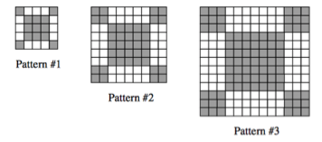
Sidewalk Stones
In Prague some sidewalks are made of small blocks of stone.
The blocks are in different shades to make patterns that are in various sizes.
How many blocks of each size will pattern #n need?
Which pattern has a total of 841 gray blocks?
How many white blocks has that pattern?
Explain your work and show your calculations.
Notes:
Here is another problem we have developed to design a good formative assessment task.
This task emerged from a photograph taken when visiting Prague.
As I wandered, I noticed that some sidewalks were made of small blocks of stone arranged to make patterns of different sizes, and
I began to wonder how many blocks of different colours were needed to make these patterns of different sizes. sk

Slide 67
Sidewalk Patterns
In Prague some sidewalks are made of small square blocks of stone.
The blocks are in different shades to make patterns that are in various sizes.
1. Draw the next pattern in this series.
2. Make a table to show the number of blocks of different shades.
3. What do you notice about the number of white blocks and the number of gray blocks?
Notes:
Questions 1 and 2 provide access so that nearly all students can demonstrate some level of success.
Question 3 gradually increases the complexity and cognitive challenge as the core mathematics is assessed.

Slide 68
Sidewalk Patterns
4. The total number of blocks can be found by squaring the number of blocks along one side of the pattern.
a. Fill in the blank spaces in this list.
25 = 5² 81 = ______ 169 = ______ 289 = 17²
b. How many blocks will pattern #5 need?
c. How many blocks will pattern #n need?
5. a. If you know the total number of blocks in a pattern you can work out the number of white blocks in it.
Explain how you can do this.
b. Pattern #6 has a total of 625 blocks.
How many white blocks are needed for pattern #6?
Show how you figured this out.
Notes:
Question 4 begins to probe for deeper understanding as students generalize the situation,
Question 5 requires an explanation in order to provide evidence into students’ thinking, and challenges them to demonstrate stronger understanding as they use their generalization.

Slide 69
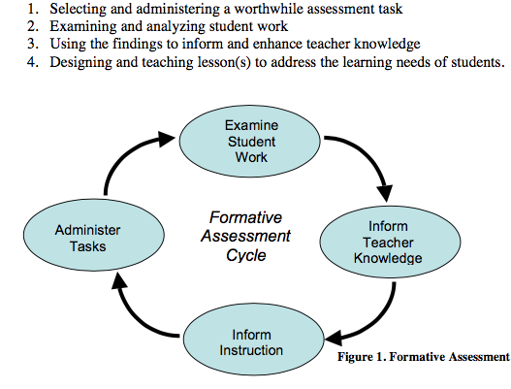
The SVMI formative assessment cycle
Notes:
For more than 10 years we were funded by the Noyce Foundation to write worthwhile assessment tasks for the Silicon Valley Mathematics formative assessment cycle which involves:
Selecting and administering a worthwhile assessment task
Examining and analyzing student work
Using the findings to inform and enhance teacher knowledge
Designing and teaching lesson(s) to address the learning needs of students

Slide 70
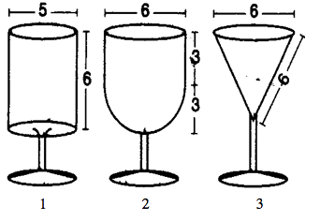
Glasses
This diagram shows three glasses (not drawn to scale).
The measurements are all in centimeters.
The bowl of glass 1 is cylindrical.
The bowl of glass 2 is a cylinder with a hemispherical bottom.
The bowl of glass 3 is an inverted cone.
1. Find the vertical height of the bowl of glass 3.
Show how you figured it out.
2. Calculate the volume of the bowl of each of these glasses
Show your work.
3. Find the height of liquid in Glass 2 when it is half full.
Explain your reasoning and show your calculations.
Notes:
Finally, here is another assessment task we have used with US students.
I thought you might like to see that not all of our assessment tasks involve looking for patterns.
.

Slide 71
The Shell Centre for Mathematical Education
– the story so far
Aspects of design
Some ways of using technology
Daniel Pead
Shell Centre Jubilee Conference
September 2017
Notes:
Systemic change and teaching modelling
Over the last sixty years, teaching modelling has moved from initial explorations to becoming an established field, supported by research and the development well-engineered tools of various kinds. Yet, in typical classrooms around the world, autonomous student modelling remains rare. Recently, in Britain and the US at least, modelling has become an explicit element in the “intended curriculum”. But the usual difficulties of embedding innovation across an education system remain. This talk will analyse these barriers and, drawing on past initiatives around the world, suggest what may be needed to overcome them.

Slide 72
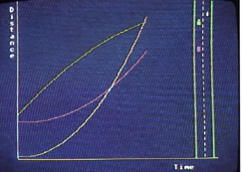
Interactive Demonstrations
TRAFFIC – Language of Functions and Graphs (1985) – Design: the Shell/ITMA team
Notes:
This is the 1985 version of the distance-time graph visualization tool ‘TRAFFIC’ running on a BBC Micro

Slide 73
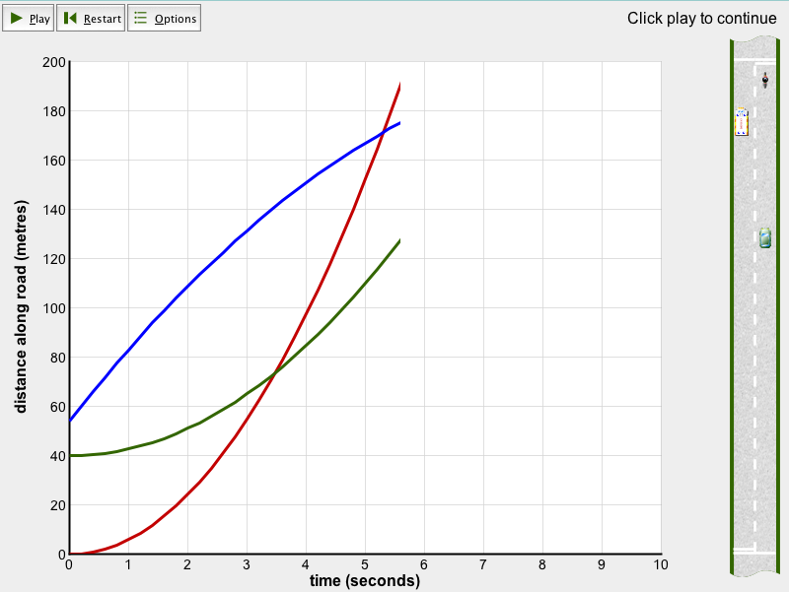
Interactive Demonstrations
TRAFFIC – 2005 version from Improving Learning in Maths
Notes:
The software was updated for the 2005 Standards Unit ‘Improving Learning in Maths’ resource.

Slide 74
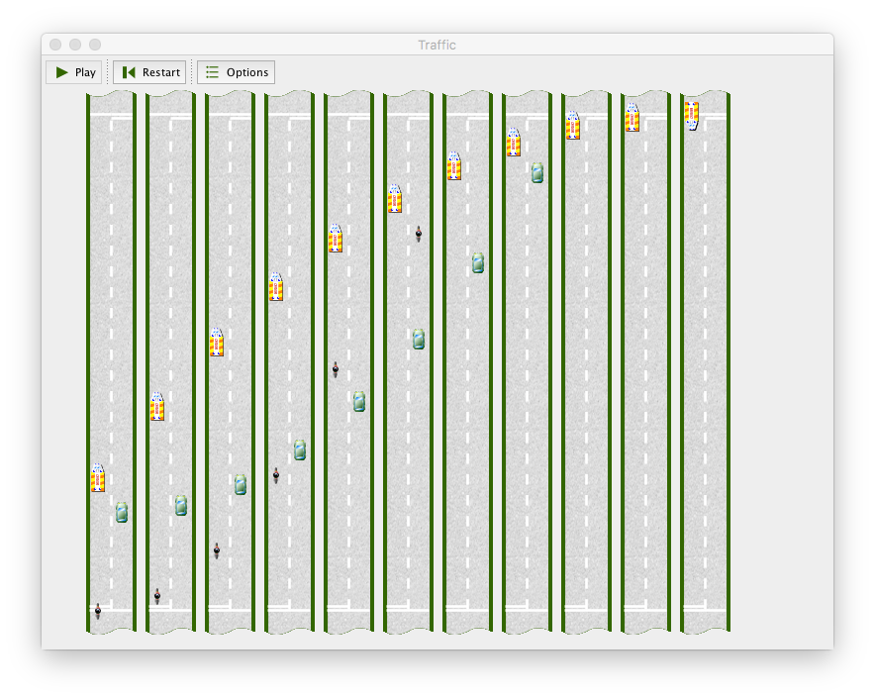
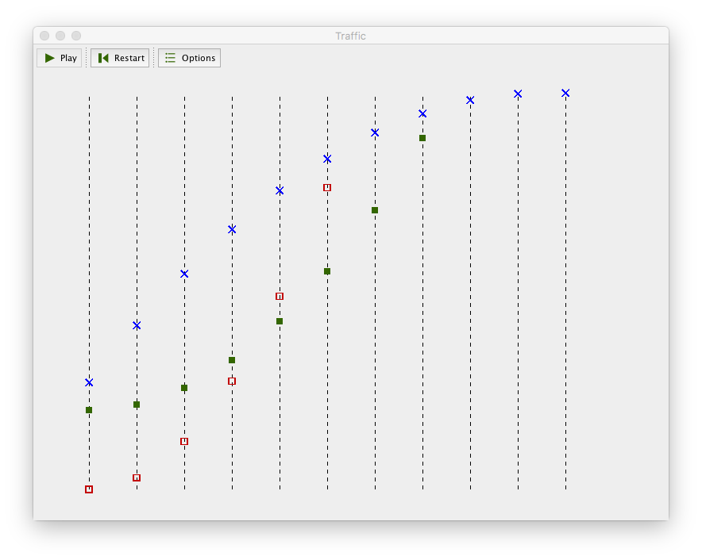
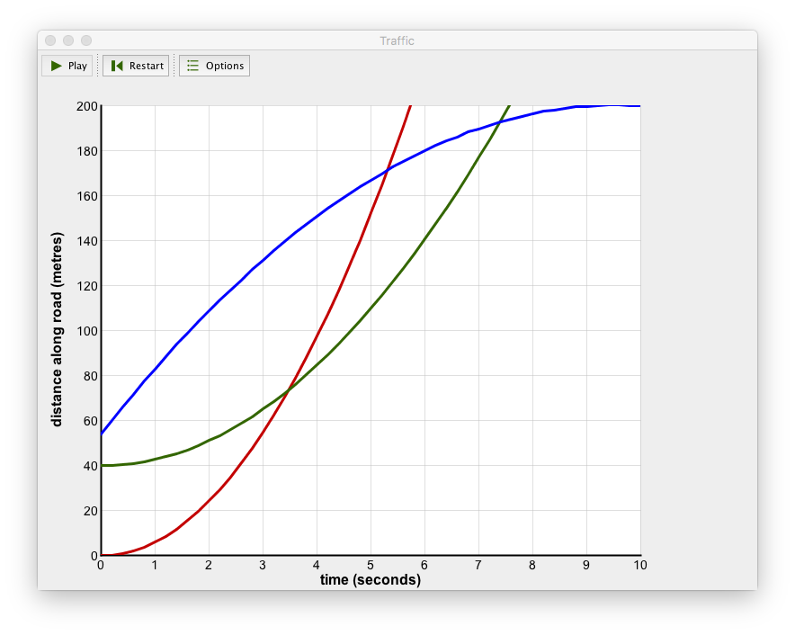
Notes:
The software shows how the distance/time graph can be developed from a series of snapshots of the road (simulated when you play this slide)…

Slide 75
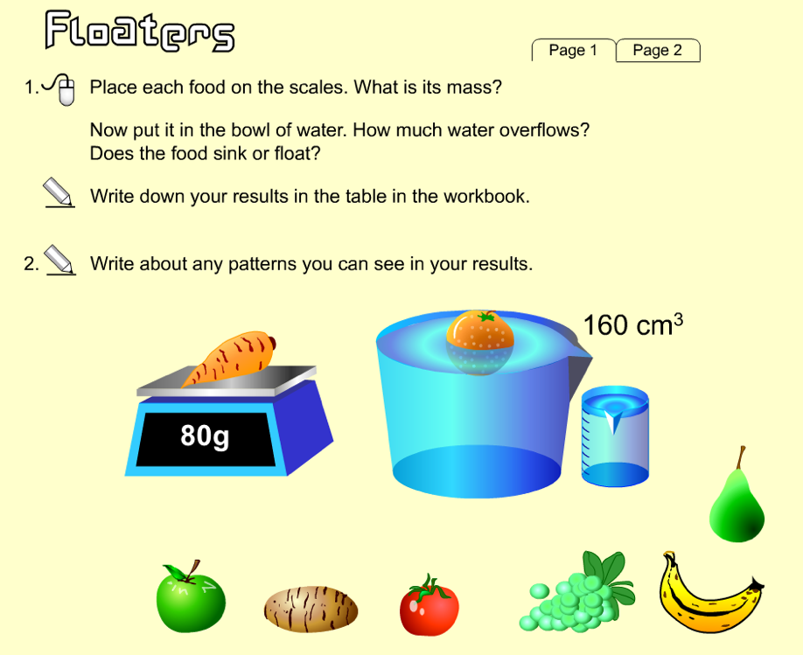
Simulated Science
From World Class Tests (200-2004) – Design: Daniel Pead & Richard Phillips
Notes:
The World Class Tests were on “problem solving in maths, science and technology” but could assume very little science knowledge from the students.

Slide 76
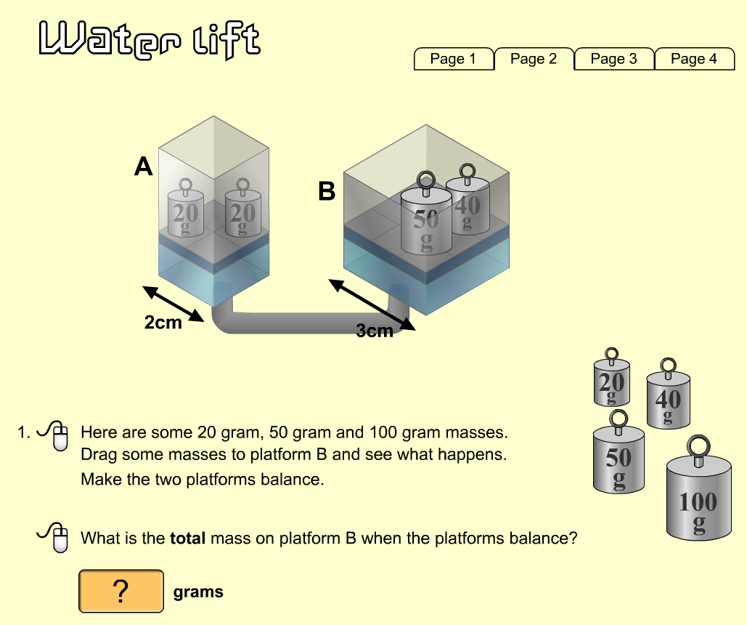
Simulated Science
From World Class Tests (200-2004) – Design: Daniel Pead

Slide 77
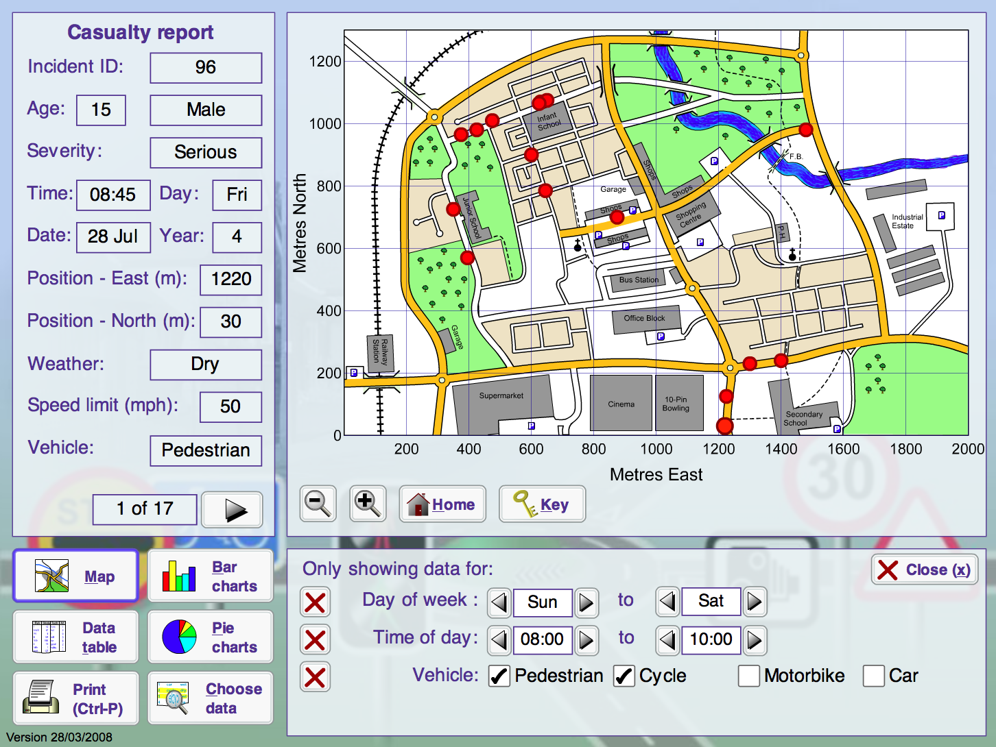
Explore a Database
From Bowland Maths (2008) – Design: Daniel Pead & Malcolm Swan
Notes:
From Bowland Maths ‘Reducing Road Accidents’ (Shell Centre, 2007) – Students had to prepare a plan for increasing road safety based on evidence from the road accident data.

Slide 78
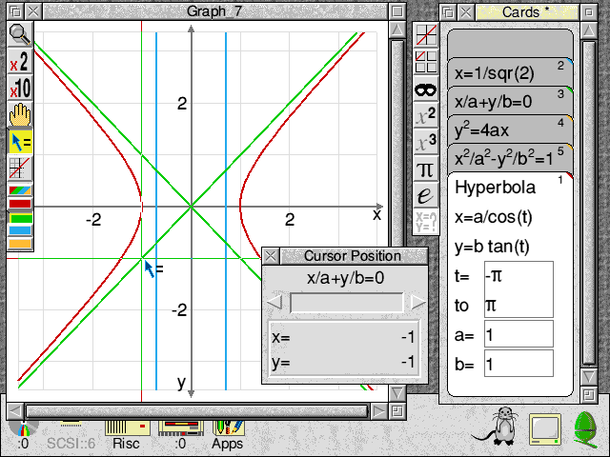
Function and Scatter Plots
Coypu (1995) – Design: Daniel Pead – Inspired by Mouse Plotter by Richard Phillips
Notes:
Coypu could plot all the usual functions, including polar and parametric plots, and could also plot many equations without first needing them to be re-arranged into functions of x.

Slide 79
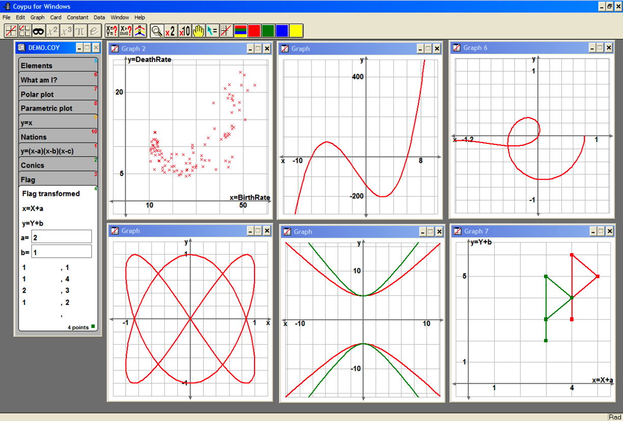
Function and Scatter Plots
Coypu (1995) – Design: Daniel Pead – Inspired by Mouse Plotter by Richard Phillips

Slide 80
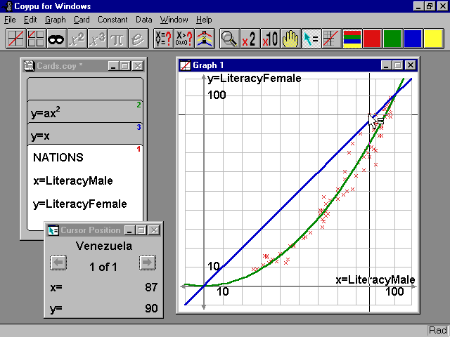
Fit data to scatter plots
Coypu (1995) – Activity designed by Richard Phillips
Notes:
Coypu could produce scatter plots from data files, and they could be mixed with function plots.

Slide 81
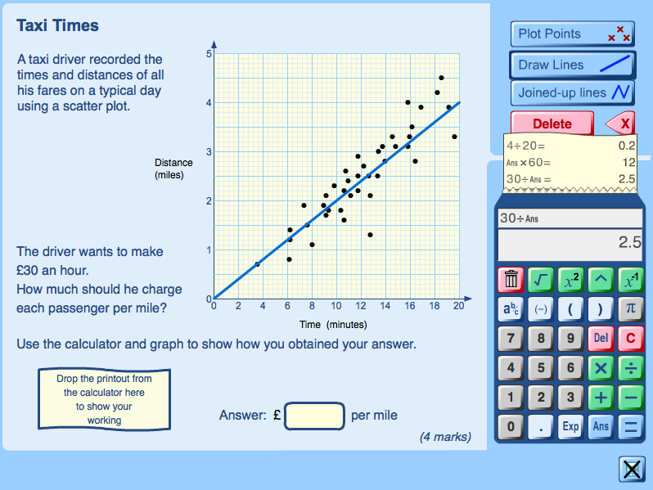
Take an Exam
Prototype online testing platform for thesis – 2005-2010
Notes:
A possible way of capturing ‘working’ in a consistent fashion in a computer-delivered test.

Slide 82

Deliver PD
Bowland Maths (2006-2014) – Software: Daniel Pead, Materials: Malcolm Swan et. al.
Notes:
Video-led professional development module from Bowland Maths.

Slide 83
The Shell Centre for Mathematical Education
– the story so far
Aspects of design
Designed student responses
Sheila Evans
Shell Centre Jubilee Conference
September 2017
Notes:
Systemic change and teaching modelling
Over the last sixty years, teaching modelling has moved from initial explorations to becoming an established field, supported by research and the development well-engineered tools of various kinds. Yet, in typical classrooms around the world, autonomous student modelling remains rare. Recently, in Britain and the US at least, modelling has become an explicit element in the “intended curriculum”. But the usual difficulties of embedding innovation across an education system remain. This talk will analyse these barriers and, drawing on past initiatives around the world, suggest what may be needed to overcome them.

Slide 84
MAP lessons:
Unstructured non-routine problems
Students can decide for themselves what method to use.
In any one class several methods may produced.
These can then be reviewed and interconnected.
MAP: Feedback from observers
Students were using just one or two methods

Slide 85
Design solution
Just because problems can be solved in different ways doesn’t mean in any one class students will do so.
Create two or three
designed student responses to each problem
Notes:
Students were not having an opportunity to consider other more efficient or more powerful methods

Slide 86


What are Designed student responses?
Notes:
They are pre-designed solutions to problems. They are hand written to imbue a freshness. They are annonymous so the mathematical prowess of the author is unknown. Usually one that we know students will be familiar with – can act as a route into other solutions.
And will have particular further features depending on the intended learning goals.

Slide 87
How designed student responses are used?
After students had tackled the problem they are presented with the responses to review:
To understand them
Critique them

Slide 88
The purpose
  Students are freed from performance demands of solving a problem.
  Students could concentrate on gaining understanding.
  Promote understanding of underlying concepts
  Promote metacognitive strategies
Notes:
Designed student response support intentional learning rather than outcomes.
The shift away from achievements may also minimise threats to collaboration. Mercer and Howe (2012) in their review of the empirical research on classroom talk suggested that students often operate on the principle of “do not share knowledge which might help you achieve better individual grades than your group partners” (p.17). By reducing performance demands, students may not feel compelled to work in this way.

Slide 89
What are the issues?
1. Understanding them
Research has found that when students explain solutions to themselves they assume they correctly understand them
  An illusion of understanding
2. Critiquing them
Students’ critique may not extend beyond assessing whether a solution is correct.
  Success criteria based on performance
Notes:
Students may harbour an illusion of understanding
Simply giving them solutions and asking them to figure out what they are about may not be enoug
In performance based classrooms Students may not see the work as important
3. Sense of satisfaction in solving a problem.

Slide 90


Design solution
Incomplete responses for students to complete
Heighten students’ metacognitive awareness of their comprehension of the response
Includes an element of performance: limits the extent the classroom culture needs to change
The responses were accurate and coherent
When critiquing students needed to focus on other aspects of each response
Students were asked to compare responses
Facilitates the noticing of more properties
of each response

Slide 91
Fosters social metacognition
Individual metacognition
Other metacognition
Socially shared metacognition

Slide 92
The Shell Centre for Mathematical Education
– the story so far
Aspects of design
Mathematical Etudes
Colin Foster
Shell Centre Jubilee Conference
September 2017
Notes:
Systemic change and teaching modelling
Over the last sixty years, teaching modelling has moved from initial explorations to becoming an established field, supported by research and the development well-engineered tools of various kinds. Yet, in typical classrooms around the world, autonomous student modelling remains rare. Recently, in Britain and the US at least, modelling has become an explicit element in the “intended curriculum”. But the usual difficulties of embedding innovation across an education system remain. This talk will analyse these barriers and, drawing on past initiatives around the world, suggest what may be needed to overcome them.

Slide 93


Slide 94
Procedural Fluency
Knowing when and how to apply a mathematical procedure and being able to perform it “accurately, efficiently, and flexibly” (NCTM, 2014, p. 1).
“The national curriculum for mathematics aims to ensure that all pupils:
become fluent in the fundamentals of mathematics…
reason mathematically…
can solve problems…”
DfE (2013, p. 2, original emphasis)

Slide 96
x + 7
2x + 4
8
4x – 8
Foster, C. (2012). Connected expressions. Mathematics in School, 41(5), 32–33.

Slide 97
Musical Etude
“originally a study or technical exercise, later a complete and musically intelligible composition exploring a particular technical problem in an esthetically satisfying manner”
Encyclopaedia Britannica

Slide 98


Slide 99


Slide 100
Are etudes as effective as traditional exercises at developing students’ procedural fluency or not?
Three quasi-experimental studies across different topic areas.
Pairs of “parallel” classes, generally the same teacher across one lesson:
  Control group: complete as many short traditional exercises as possible
  Intervention group: tackle a mathematical etude on the same content
Pre- and post- tests administered at the beginning and end of the lesson.

Slide 104
Results
 | Study 1 Expression Polygons | Study 2 Devising Equations | Study 3 Enlargements | Total
N | 193 | 194 | 141 | 528
Ages | 12-14 | 12-14 | 13-15 | 12-15
Schools | 3 | 5 | 3 | 11
Bayesian analysis and meta-analysis

Slide 105
Are etudes as effective as traditional exercises at developing students’ procedural fluency or not?
No difference!
Even if all you care about is that students develop lots of procedural fluency ...
... you might as well use etudes!
And they are likely to have other (harder-to-measure) benefits too:
Creative investigative inquiry
Surprise and delight
Communication
...

Slide 106
Further Work
Try to quantify harder-to-measure benefits of etudes
Delayed post-tests
Examine what happens differently with etudes
Other ages and topics
For more details see:
Foster, C. (in press). Developing mathematical fluency: Comparing exercises and rich tasks. Educational Studies in Mathematics.
Foster, C. (2013). Mathematical études: Embedding opportunities for developing procedural fluency within rich mathematical contexts. International Journal of Mathematical Education in Science and Technology, 44(5), 765–774.

Slide 107
The Shell Centre for Mathematical Education
– the story so far
Aspects of design
Developing Conceptual Understanding
Clare Dawson
Shell Centre Jubilee Conference
September 2017

Slide 108

Teacher -> Designer

Slide 109

Conceptual Understanding
Swan, M. (2008) A Designer Speaks. Educational Designer, 1(1)

Slide 110
Teaching for Conceptual Understanding is more effective when we …
Use rich, collaborative tasks
Develop mathematical language
Build on the knowledge students already have
Confront difficulties rather than avoid/pre-empt
Expose and discuss common misconceptions
Use higher-order questions
Make appropriate use of whole class interactive teaching, individual work and small group work
Encourage reasoning rather than ‘answer getting’
Create connections between topics
Recognise what has been learned and how
Swan, M. (2008) A Designer Speaks. Educational Designer, 1(1)

Slide 111
Task Design Features
Accessible, flexible, rich tasks
Build on students’ existing ideas
Expose misconceptions and confront conflict
Emphasise reasons rather than answers
Extend and link learning

Slide 112
Accessible, flexible, rich tasks
Mathematics Assessment Project: Transforming 2D Figures

Slide 113

Build on students’ existing ideas
A citrus farm grows orange trees to make orange juice.
What information might you need to know to help you to work out how much orange juice the farm can produce?
NCETM Multiplicative Reasoning Project: Exploring Multiplicative Structures

Slide 114


Expose misconceptions and confront conflict
Two batches of milkshake are made by mixing cartons of juice with cartons of milk:
Both batches have two more cartons of milk than juice so they will taste the same
In Batch 1, of the milkshake is juice,
whereas in Batch 2, of the milkshake is
juice so they will taste different
Beth and Charlie can’t agree on whether the two batches of milkshake will taste
the same. Determine whether the two batches will taste the same, commenting
on the two reasons given.
NCETM Multiplicative Reasoning Project: Milkshakes

Slide 115
Emphasise reasons rather than answers
Triangle ABC is isosceles with AB = 5cm and Angle B = 48 degrees.
Triangle DEF is isosceles with DE = 5cm and Angle E = 48 degrees.
Explain why the two triangles may not be identical.
Mathematics Assessment Project: Describing and Defining Triangles

Slide 116

Extend and link learning
Mathematics Assessment Project: Classifying Solutions to Systems of Equations

Slide 117
Task Design Features
Accessible, flexible, rich tasks
Build on students’ existing ideas
Expose misconceptions and confront conflict
Emphasise reasons rather than answers
Extend and link learning

Slide 118
The Shell Centre for Mathematical Education
– the story so far
Aspects of design
Formative assessment using iPad technology (FasMED project)
Diane Dalby
Shell Centre Jubilee Conference
September 2017
Notes:
Systemic change and teaching modelling
Over the last sixty years, teaching modelling has moved from initial explorations to becoming an established field, supported by research and the development well-engineered tools of various kinds. Yet, in typical classrooms around the world, autonomous student modelling remains rare. Recently, in Britain and the US at least, modelling has become an explicit element in the “intended curriculum”. But the usual difficulties of embedding innovation across an education system remain. This talk will analyse these barriers and, drawing on past initiatives around the world, suggest what may be needed to overcome them.

Slide 119
Characteristics of the design process
Collaboration between teachers and researchers in lesson designs.
Knowledge-sharing between teachers and researchers became essential since each had specific knowledge of value.
Experimentation with uses of technology rather than refinement of a product.

Slide 120



Formative assessment and iPad technology
Building on students’ prior knowledge
Pre-lesson diagnostic assessment and class overviews are used in lesson planning.
Identifying and responding to students’ conceptual difficulties
Sample student work is selected and displayed to expose misconceptions.

Slide 121



Formative assessment and iPad technology
Using questioning
Student work is displayed and students are questioned about their methods.
Increasing student collaboration
Students compare and discuss their work even when working on individual iPads.
Enabling students to become assessors
Peer assessment takes place during class discussion and collaborative work.

Slide 122
Nested formative processes
Identification of teacher-led and student-led processes over different time spans and the ‘nesting’ of these within each other.
EXAMPLE
Teacher selects samples for display and discussion to expose misconceptions
Teacher sends question electronically
Students work on their responses
Teacher receives responses electronically
Students discuss and collaborate with each other
Students engage in peer assessment, self reflection and adjustment to thinking

Slide 123
 | Where the learner is going | Where the learner is right now | How to get there
TEACHER | A. Clarifying learning intentions and criteria for success | B. Engineering effective classroom discussions and other learning tasks that elicit evidence of student understanding | C. Providing feedback that moves learners forward
PEER | D. Understanding (shared) learning intentions and criteria for success | E. Activating students as instructional resources for one another
LEARNER | D. Understanding learning intentions and criteria for success | E. Activating students as the owners of their own learning
(Thompson and Wiliam, 2007)

Slide 124
Processes and actors
Formative process:
ASK ANSWER ANALYSE ADAPT
Actors:
Teachers
Students
IPad technology

Slide 125


EXAMPLE 1
The teacher sends a question to the students electronically. The students work individually, record their solutions and working on their iPads and send these responses electronically to the teacher. The teacher displays a sample student response and asks the class to comment on the solution. The students provide feedback on the sample student response. The teacher may also provide feedback. The student interprets this feedback and is challenged to rethink their solution.

Slide 126


EXAMPLE 2
The teacher sends a question to the students electronically. The students work individually to work out solutions on their iPads and record their methods. The students then compare and discuss solutions with each other in groups. Individual students receive feedback on their solutions from their peers. Students interpret the feedback, adjust their thinking and produce improved solutions.

Slide 127


EXAMPLE 3
The software generates a series of questions. Students respond individually and enter their responses. The software processes each response, provides feedback to the student and adapts the next question, making it easier or harder depending on the response elicited. The teacher can access an overview of individual and group progress at time and intervene if necessary.

Slide 128
The Shell Centre for Mathematical Education
– the story so far
Aspects of design
From strategic to technical design
Geoff Wake
Shell Centre Jubilee Conference
September 2017

Slide 129
Design at different levels
Strategic: concerned with the overall structure of the product set and how it will relate to the user-system
Tactical: focused on the overall internal structure of the product
Technical: focused on the design of individual elements of the product relevant to the end users and their environment
http://www.educationaldesigner.org/ed/volume1/issue3/article9/

Slide 130

Strategic

Slide 131


Strategic

Slide 132

Tactical

Slide 133



Tactical

Slide 134


Tactical
Modelling
Comprehension
Communication

Slide 135

Technical

Slide 136



Technical

Slide 137



Technical

Slide 138
Design required at all levels
Strategic: concerned with the overall structure of the product set and how it will relate to the user-system
Tactical: focused on the overall internal structure of the product
Technical: focused on the design of individual elements of the product relevant to the end users and their environment
http://www.educationaldesigner.org/ed/volume1/issue3/article9/

Slide 139
Now for the reception!
Shell Centre Jubilee Conference
September 2017
Notes:
Systemic change and teaching modelling
Over the last sixty years, teaching modelling has moved from initial explorations to becoming an established field, supported by research and the development well-engineered tools of various kinds. Yet, in typical classrooms around the world, autonomous student modelling remains rare. Recently, in Britain and the US at least, modelling has become an explicit element in the “intended curriculum”. But the usual difficulties of embedding innovation across an education system remain. This talk will analyse these barriers and, drawing on past initiatives around the world, suggest what may be needed to overcome them.

